Slide 1
LECTURE 07 Induction

Slide 2
What you will learn in this lecture:
Mathematical Induction
Strong Induction

Slide 3
Motivation
Consider the following property of positive integer:
The sum of the first n positive integers is
Often such property (and many others) can be represented as a predicate, P(n), and the property said that P(n) is true for all positive integers n.
How to prove them?
Use mathematical induction

Slide 4
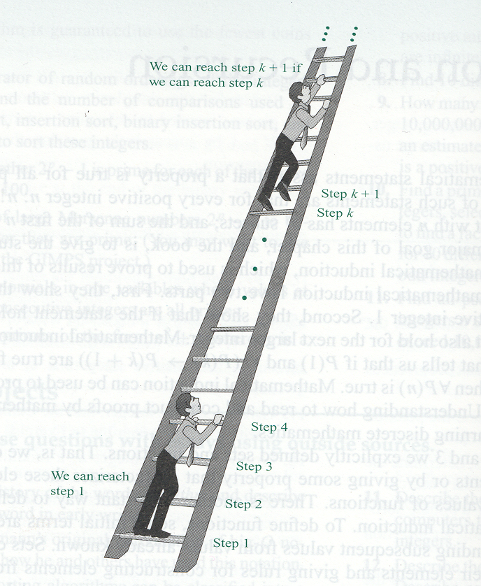
The Principles of Mathematical Induction
The Principles of Mathematical Induction:
A technique for proving certain types of mathematical statements is true
for all positive integers, or for all positive integers from some point on.

Slide 5
The Principles of Mathematical Induction
Let P(n) be a proposition depending on n, where n is a positive integer.
To prove P(n) is true for all positive integers, it suffices to prove:
P(1) is true
For all k ≥ 1, P(k + 1) is true whenever P(k) is true: P(k) → P(k + 1)
[P(1) ∧ ∀k {P(k) → P(k+1)}] ⇒ ∀n P(n)

Slide 6
The 3 Steps of Mathematical Induction (for nonnegative or positive integers)
1. Inductive base:
Show that P(base value) is true. Note that base value not always =1.
2. Inductive hypothesis:
Assume P(k) is true.
3. Inductive step:
Show that P(k + 1) is true on the basis of the inductive hypothesis.

Slide 7
Example 1: Use Mathematical Induction to prove that the sum of the first n
positive integers is .
Solution:
Let P(n) be the proposition that , for n = 1, 2, 3, ….
Proof by induction.
1) Inductive base: n = 1
Left side of the equation = 1
Right side of the equation =
Hence P(1) is true.
2) Inductive hypothesis: n = k
Assume that P(k) is true, i.e.
3) Inductive step: n = k + 1
We have shown that P(k + 1) is true whenever P(k) is true.
By mathematical induction, P(n) is true for all n ≥ 1 .

Slide 8
Example 2: Use mathematical induction to prove the inequality for all
positive integers n.
Solution:
Let P(n) be the proposition , for n = 1, 2, 3, ….
Proof by Induction
1) Inductive base: n = 1
LHS of the inequality = 1, RHS of the inequality = 2¹ = 2
Since 1 < 2, P(1) is true.
2) Inductive hypothesis: n = k
Assume P(k) is true, which means k < 2^{k}.
3) Inductive step: n = k + 1
We want to show that P(k+1) is true, i.e. we want to show that k+1 < 2^{k+1}.
Now, k + 1 ≤ k + k = 2k < 2(2^{k}) = 2^{k+1}.
By assuming P(k) is true, we have shown that P(k+1) is true.
Thus by mathematical induction, P(n) is true for all n ≥ 1.

Slide 9
Example 3: Show that stamps for any value 8 cents or more is obtainable with 3 cents and 5 cents stamps.
Solution:
1) Inductive base: n = 8 cents
The value 8 cents is obtained by a 3 cents plus a 5 cents stamp.
2) Inductive hypothesis: n = k cents
Assume that k cents is obtainable with 3 cents and 5 cents stamps.
3) Inductive step: n = (k + 1) cents
Case 1. The k cents is obtained using a 5 cents stamp (among others). Replace
the 5 cents stamp by two 3 cents stamps, thus obtaining k + 1 cents.
Case 2. If the k cents is obtained using only 3 cents stamps, there are at least
three of them (since k >= 8). In this case, replace three 3 cents stamps
by two 5 cents stamps, again obtaining k + 1 cents.
Thus in either case, when k >= 8, if k cents is obtainable then k + 1 cents is
obtainable.
This completes the induction proof that n cents are obtainable from 3 cents and 5 cents stamps, for all natural numbers n >= 8.

Slide 10
Strong Induction
Similar steps as the ordinary mathematical induction.
However, the basis step may contain the proof for more than one initial values.
Also the assumption is made for not just one value of n, but for all values throughout k.

Slide 11
Example 4: Prove that the every integer in the sequence a₀, a₁, a₂, … that is defines as
a₀ = 2, a₁ = 6, a_{n} = a_{n - 1} + a_{n - 2} for all n >= 2
is even.
Solution:
1) Inductive base: n = 0 and n = 1
Given that a₀ = 2, a₁ = 6 thus a_{n} is even for n = 0 and n = 1
2) Inductive hypothesis: n = 0, 1, 2, … k
Assume that a_{n} is even for n = 0, 1, 2, … k
3) Inductive step: n = k + 1
From inductive hypothesis, a_{k} is even so a_{k} = 2m for integer m and a_{k – 1} = 2n
for integer n
a_{k + 1} = a_{k} + a_{k – 1} = 2m + 2n = 2(m + n)
Thus a_{k + 1} is even whenever a_{n} is even for n = 0, 1, 2, … k

Slide 12
Try this:
Use mathematical induction to prove that 3 divides n³ – n, where n is positive integer.

Slide 13
Summary
We have discussed the concepts related to the principles of mathematical induction:
There are 3 steps to prove by induction (ordinary or strong):
1. Inductive base
2. Inductive hypothesis
3. Inductive step
You should always take note on the differences between ordinary induction and strong induction.

Slide 14
Exercise 1
Infer a formula for the sum of the first n positive odd integers. Then using mathematical induction, prove your inference.
Solution:

Slide 15
Exercise 2
Use mathematical induction to show that for all positive integers n ≥ 4,
Solution:

